Slide 1
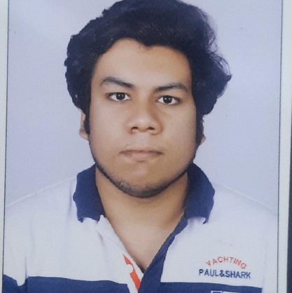
Vishnu Pillai
BTech in
Mechanical Engineering: 2018 - 2022
Skills Java 8
Spring Boot
Spring MVC
JPA CRUD
MERN Stack
ReactJS
MongoDB
Database
No SQL database – MongoDB
Web Technologies
HTML5
CSS3
Javascript
Addon's
GitHub
Maven
Postman
RabbitMQ
Additional Details
Leadership
Excellent Communication Skills
Team management
Analyst/Software Engineer
Chennai
Vishnu.pillai@capgemini.com
+91 9818247951
A4
Software Engineer who is Strong in frontend as well as backend development. Passionate about implementing and launching new projects.
Ready to learn new technologies and implement them to further improve my knowledge.
Development experience using MongoDb data .
Has working knowledge on ReactJS(Hooks, HTML, CSS)and Java Spring boot Microservice Development using Spring framework on an intermediate level.
Also implemented RabbitMq as a messaging service in Springboot Microservice.
Hotel Management System
Completed end to end case study of Hotel Management System along with Autho with MongoDB database authentication, Swagger. Material-UI and React Bootstrap used for user interface.
HTML CSS JAVASCRIPT for web developers
Completed Design responsive web pages with Html , CSS and JavaScript.
Completed the Capgemini Adapt Java full stack react training
https://github.com/vishnupillai704/Hotel-Management-System

